Slide 1
CAPSTONE PROJECT
Employee Salary Prediction
Using Machine Learning Algorithms
Presented By:
Soumya Ranjan Dash
Ravenshaw University, Cuttack, Odisha
Department of Information Technology & Management (ITM)
AICTE Student ID: STU683351a9df4481748193705

Slide 2
OUTLINE:
Problem Statement
System Development Approach
Algorithm & Deployment
Result
Conclusion
Future Scope
References

Slide 3
Problem Statement:
In today’s data-driven world, understanding what factors influence an employee’s income is more important than ever. Organizations often lack accurate tools to predict salaries based on individual profiles like education, work hours, or job type. Most public datasets only provide broad income categories, making it difficult to estimate real earning potential. There’s a clear need to process such raw data and build models that go beyond simple classifications. This project addresses that gap by exploring how personal and professional attributes can help estimate actual income figures.

Slide 4
System Approach:
This project follows a structured and modular approach to develop an efficient salary prediction system using machine learning techniques. It covers data preprocessing, model training, evaluation, and a user-friendly web deployment.
System Requirements
Hardware:
Any modern PC/Laptop with minimum 4GB RAM
Internet connection for deployment/testing (Streamlit)
Software:
Jupyter Notebook / VS Code
Python 3.12+
Streamlit for web interface
Web browser (Chrome, Edge, etc.)
Operating System:
Windows, macOS, or Linux (platform-independent)

Slide 5
Libraries & Tools Used:
Pandas – For data manipulation and preprocessing
NumPy – For numerical computations
Matplotlib / Pyplot – For data visualization
Scikit-learn (sklearn) – For machine learning algorithms (Linear Regression, Random Forest, etc.)
Joblib – For saving and loading trained models
Streamlit – For creating the web app interface
LabelEncoder – For categorical value encoding

Slide 6
Algorithm & Deployment:
Data Collection:
Dataset obtained from [Adult Income Dataset (UCI Repository)] or internship-provided dataset.
Raw .csv file loaded into the environment for analysis.
2. Data Preprocessing:
Column Filtering (Feature Minimization)
Dropped irrelevant or redundant columns such as ‘education’ (duplicate of educational-num), ‘relationship’, ‘capital-gain’, ‘capital-loss’ and ‘race’.
Retained only those features relevant to income prediction.
Missing Value Handling
Detected and removed rows with missing or undefined values (e.g., entries with '?' in categorical columns like workclass and occupation) ensuring no noise or bias was introduced due to incomplete data.

Slide 7
Converted categorical features into numerical format using LabelEncoder.
Identified and removed outliers using boxplots and statistical thresholds (e.g., ages above 75).
Removed domain-irrelevant entries such as low education levels (5th-6th grade) and work statuses like Never-worked or Without-pay.
Stored label mappings for reverse conversion and user-friendly display in the app.
Final selected input features: ['age', 'workclass', 'educational-num', 'marital-status', 'occupation', 'gender', 'hours-per-week', 'native-country'].
Target variable transformed from binary classification to realistic income estimations for regression modeling.
Model Building & Evaluation:
Multiple regression models trained:
Linear Regression
Random Forest
Gradient Boosting
SVR
KNN

Slide 8
Each model evaluated using:
R² Score (for accuracy of predictions)
MAE (Mean Absolute Error)
Best model (GradientBoosting) selected based on highest R² score.
Model Saving
Best performing model saved using joblib as best_model_regression.pkl
Web App Deployment
Frontend built using Streamlit for user interaction.
Users enter input values (age, workclass, education level, etc.) through dropdowns/sliders.
Model predicts the estimated income based on inputs.
Supports batch prediction via .csv upload.
Application is hosted locally or deployed to platforms like Streamlit Cloud for sharing.

Slide 9
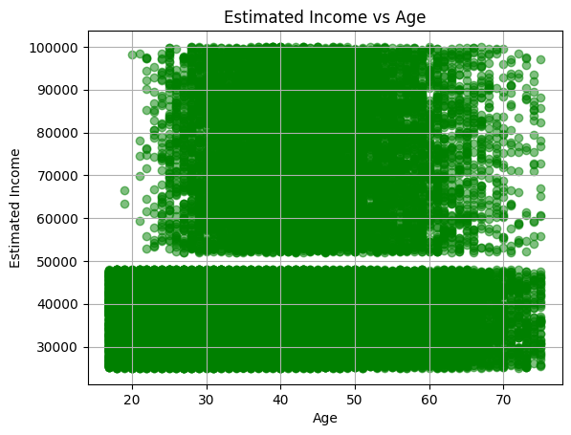
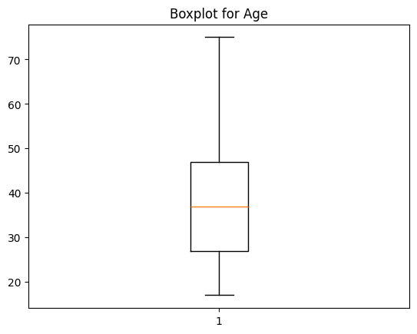
Result:
plt.scatter(df['age'], df['estimated-income'], alpha=0.5,color='green’)
plt.title('Estimated Income vs Age’)
plt.xlabel('Age’)
plt.ylabel('Estimated Income’)
plt.grid(True)
plt.show()
df=df[(df['age']<=75)&(df['age']>=17)]
plt.boxplot(df['age’])
plt.title('Boxplot for Age’)
plt.show()

Slide 10
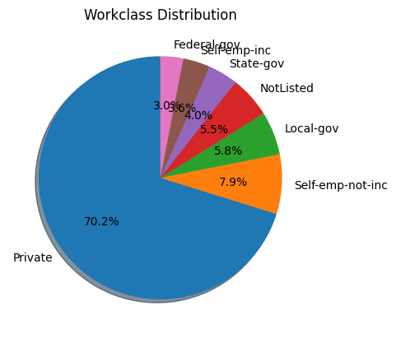
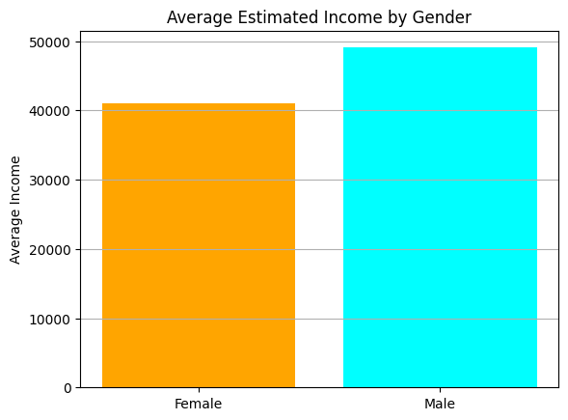
df['workclass'].value_counts().plot.pie(autopct='%1.1f%%', startangle=90, shadow=True)
plt.title('Workclass Distribution’)
plt.ylabel(‘’)
plt.show()
avg_income_by_gender = df.groupby('gender')['estimated-income'].mean()
plt.bar(avg_income_by_gender.index, avg_income_by_gender.values, color=['orange', 'cyan’])
plt.title('Average Estimated Income by Gender’)
plt.ylabel('Average Income’)
plt.grid(True, axis='y’)
plt.show()

Slide 11
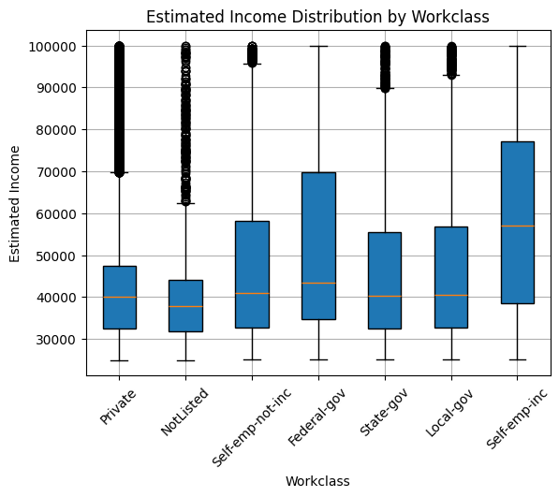
workclasses = df['workclass'].unique()
income_by_class = [df[df['workclass'] == w]['estimated-income'] for w in workclasses]
# Plotting
plt.boxplot(income_by_class, tick_labels=workclasses, patch_artist=True)
plt.title('Estimated Income Distribution by Workclass’)
plt.xlabel('Workclass’)
plt.ylabel('Estimated Income’)
plt.xticks(rotation=45)
plt.grid(True)
plt.show()

Slide 12
from sklearn.preprocessing import LabelEncoder
encoder=LabelEncoder()
df['workclass']=encoder.fit_transform(df['workclass'])
df['marital-status']=encoder.fit_transform(df['marital-status'])
df['occupation']=encoder.fit_transform(df['occupation’])
df['gender']=encoder.fit_transform(df['gender’])
df['native-country']=encoder.fit_transform(df['native-country’])
df
age | workclass | educational-num | marital-status | occupation | gender | hours-per-week | native-country | estimated-income
0 | 25 | 3 | 7 | 4 | 5 | 1 | 40 | 39 | 33966
1 | 38 | 3 | 9 | 2 | 3 | 1 | 50 | 39 | 43203
3 | 44 | 3 | 10 | 2 | 5 | 1 | 40 | 39 | 85393
4 | 18 | 2 | 10 | 4 | 7 | 0 | 30 | 39 | 38041
5 | 34 | 3 | 6 | 4 | 6 | 1 | 30 | 39 | 32136
... | ... | ... | ... | ... | ... | ... | ... | ... | ...
48837 | 27 | 3 | 12 | 2 | 10 | 0 | 38 | 39 | 30500
48838 | 40 | 3 | 9 | 2 | 5 | 1 | 40 | 39 | 65100
48839 | 58 | 3 | 9 | 6 | 0 | 0 | 40 | 39 | 33053
48840 | 22 | 3 | 9 | 4 | 0 | 1 | 20 | 39 | 25486
48841 | 52 | 4 | 9 | 2 | 2 | 0 | 40 | 39 | 57191

Slide 13
import matplotlib.pyplot as plt
model_names = list(results.keys())r2_scores = [results[m]["R2"] for m in model_names]
mae_scores = [results[m]["MAE"] for m in model_names]
plt.figure(figsize=(14, 6))
plt.subplot(1, 2, 1)
bars1 = plt.bar(model_names, r2_scores, color='mediumseagreen’)
plt.title("R² Score Comparison", fontsize=14)
plt.ylabel("R² Score", fontsize=12)
plt.ylim(0, 1)
plt.grid(axis='y', linestyle='--', alpha=0.7)
for bar in bars1:
yval = bar.get_height()
plt.text(bar.get_x() + bar.get_width()/2, yval + 0.01, f"{yval:.2f}", ha='center', fontsize=10)
plt.subplot(1, 2, 2)
bars2 = plt.bar(model_names, mae_scores, color='tomato’)
plt.title("Mean Absolute Error (MAE) Comparison", fontsize=14)
plt.ylabel("MAE", fontsize=12)
plt.grid(axis='y', linestyle='--', alpha=0.7)
for bar in bars2:
yval = bar.get_height()
plt.text(bar.get_x() + bar.get_width()/2, yval + 500, f"{yval:.0f}", ha='center', fontsize=10)
plt.suptitle("Model Performance Metrics", fontsize=16)
plt.tight_layout(rect=[0, 0, 1, 0.95])
plt.show()

Slide 14
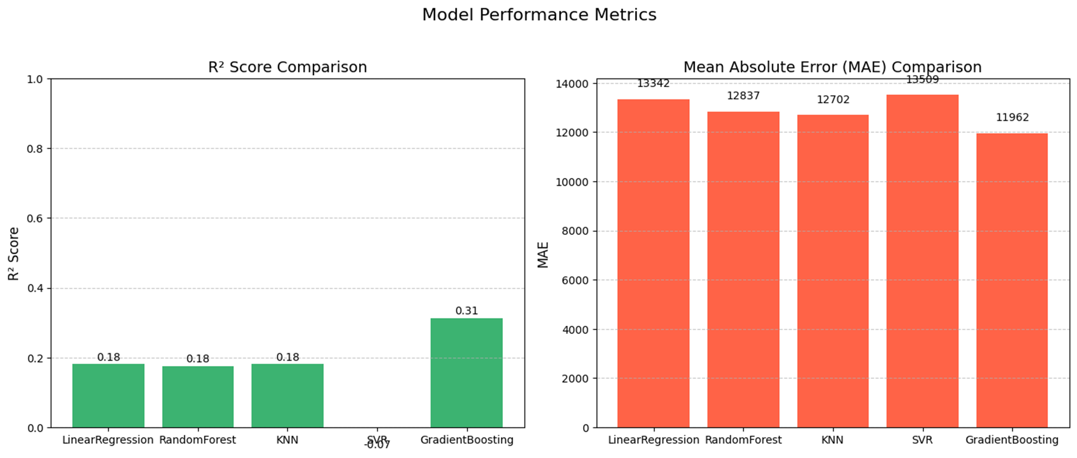
GitHub Link: click here

Slide 15
Conclusion:
The project successfully demonstrated the development of a machine learning-based web application to predict estimated income using demographic and employment-related features.
Through thorough data preprocessing, feature engineering, and evaluation of multiple regression algorithms, Gradient Boosting Regressor emerged as the best-performing model with an R² score of 0.3133 and lowest MAE.
The system was deployed using Streamlit, providing both single and batch prediction interfaces with a user-friendly UI.
Key challenges included handling inconsistent categorical data, selecting meaningful features, and replacing binary income labels with realistic numeric estimates.
Future improvements could include enhancing model accuracy using advanced techniques (like XGBoost or ensembling), integrating more diverse datasets, and allowing dynamic model switching in the deployed app.

Slide 16
Future scope:
Model Switching Option: Enhance the application to allow users to dynamically switch between different ML models (e.g., Linear Regression, Random Forest, Gradient Boosting) and compare their predictions in real-time.
Improved Accuracy: Experiment with more advanced algorithms such as XGBoost, CatBoost, or LightGBM to further improve the predictive performance.
Real-Time Data Integration: Connect the system to APIs or real-time databases to allow predictions based on live or frequently updated data.
Automated Feature Engineering: Integrate feature selection and transformation techniques that adapt automatically based on the dataset characteristics.
Interactive Visualizations: Add more data analysis visuals and explainable AI tools (e.g., SHAP values) within the app to help users understand the model's decisions.
User Authentication & History Tracking: Allow users to log in, save their prediction history, and compare results across time or models.
Dataset Expansion: Use richer datasets that include additional attributes like company size, sector, previous employment, etc., to enhance prediction depth.

Slide 17
References:
IBM SkillsBuild Platform – AI/ML Training Modules and Resources https://skillsbuild.org
UCI Machine Learning Repository – Adult Income Dataset https://archive.ics.uci.edu/ml/datasets/adult
Scikit-learn Documentation – Machine Learning in Python https://scikit-learn.org/stable/documentation.html
Streamlit Documentation – Web App Development for ML https://docs.streamlit.io
Python Official Documentation https://docs.python.org/3/

Slide 18

Thank You

